Slide 1

Pulses overview; status and opportunities for genetic enhancement
Ramavtar Sharma
Presented during Group meeting organized by ICAR-ATARI, Jodhpur for 26-27 July 2018-19

Slide 2
Area, Production and Productivity
India is the largest producer (25% of global production),
consumer (27% of world consumption) and
importer (14%) of pulses in the world.
Pulses account for around 20 per cent of the area under foodgrains and
contribute around 7-10 per cent of the total foodgrains production in the country.
Though pulses are grown in both Kharif and Rabi seasons,
Rabi pulses contribute more than 60 per cent of the total production.
Gram is the most dominant pulse having a share of around 40 per cent in the total production followed by
Tur/Arhar at 15 to 20 per cent and
Urad/Black Matpe and Moong at around 8-10 per cent each.
Productivity of pulses is 764 kg/ha.

Slide 3
Objectives of Genetic Improvement
Yield improvement:
Yield and yield stability needs proper consideration
Strategies:
Plant/crop architecture (ideotype/architype breeding)
Drought/heat/irradiation tolerance (Abiotic stresses)
Pest and Disease resistance (Biotic stresses)

Slide 4
Pertinent Improvement strategies:
Recombinant breeding
Mutagenesis/mutation breeding
Wide hybridization
Biotechnological tools:
  Organogenesis
  Embryo rescue/Inter-specific hybrids through embryoculture
  Protoplast culture and embryogenesis
  Somaclonal variation: in vitro selection
  Transgenic Plants: disease/pest resistance
Molecular Marker assisted selection

Slide 5
Thrust areas:
Exploitation of heterosis in pigeonpea
Integrated approach for genetic enhancement through pre-breeding
Development of suitable plant types for different agro-ecological conditions
Genomics-enabled pulse crops improvement
Breeding for tolerance to drought & temperature extremities
Breeding for improved quality
Plant genetic resources management
Maintenance breeding & breeder seed production

Slide 6
Chickpea:
Genetic enhancement and pre-breeding for yield enhancement and broadening the genetic base of existing cultivars.
Pyramiding of genes conferring resistance to fusarium wilt and dry root rot through integrated plant breeding approach.
Development of heat and moisture stress tolerant varieties (QTLs identification for drought, mechanism of heat tolerance etc.).
Development of chickpea varieties suitable for
  mechanical harvesting and
  post emergence herbicide tolerance.

Slide 7
Pigeonpea:
Exploitation of heterosis and development of commercial CGMS based hybrids.
Development of improved varieties possessing resistance to major biotic and abiotic stresses, and genetic enhancement through pre-breeding in long duration pigeonpea.
Development of early maturing varieties insulated against pod fly damage.

Slide 8
Urdbean:
High yielding varieties with
  sympodial bearing (soybean type),
  green or black seeds,
  possessing resistance against yellow mosaic virus and Cercospora leaf spot.
Development of high yielding, MYMIV/MYMV and Cercospora leaf spot resistant
  varieties for spring/summer seasons.

Slide 9
Mungbean:
Genetic improvement for grain yield and diseases resistance in short maturity background for spring/summer season.
Development of
  medium-short duration,
  non-shattering varieties
  tolerating pre-harvest sprouting and
  resistant to major diseases for kharif and rabi season.

Slide 10
Lentil:
High yielding varieties possessing resistance to fusarium wilt, rust and stem phyllium blight, and
  combining higher biomass and
  early maturity for rice-fallow and utera cultivation.
Field pea:
Genetic improvement for grain yield by combining
  higher biomass,
  stiff stem and
  few leaflets traits besides powdery mildew and rust resistance.

Slide 11
Research strategies:
Pre-breeding efforts to break yield ceiling and broaden the genetic base.
Development of mapping populations for targeted traits in major pulse crops.
Mapping and tagging of genes and MAS for insulating varieties against major diseases.
Identification of QTLs for improving grain yield and quality traits.
Utilization of off-season nurseries for rapid generation advancement.
Diverting sincere efforts in basic and strategic research.
Allele mining of genes of agricultural importance.

Slide 12
Varieties developed: Large number varieties of different pulses have been developed by IIPR.
Crop | Variety name
Chickpea | DCP 92-3 : Desi
 | IPC 97-67(SCS-3): Desi
 | IPCK 2002-29 ( Shubhra): Kabuli
 | IPCK 2004-29 ( Ujjawal): Kabuli
Pigeon pea | IPA 203
 | IPH 09-5 (Hybrid)
Field pea | IPF 99-25 (Adarsh)
 | IPFD 99-13 (Vikas)
 | IPFD 1-10( Prakash)
 | IPFD 5-19( Aman)
 | IPF 4-9
 | IPFD 6-3
Rajmash | PDR 14 (Uday)
 | IIPR 96-4(Amber)
 | IPR 98-5(Utkarsh)
 | IPR 98-3-1(Arun)
Mungbean | PDM 11 (Basanti)
 | PDM 54(Moti)
 | PDM 139(Samrat)
 | IPM 99-125(Meha)
 | IPM 02-14
 | IPM 02-3
Urdbean | PDU 1(Basant Bahar)
 | IPU 94-1(Uttara)
 | IPU 02-43
 | IPU 07-3
Lentil | DPL15(Priya)
 | DPL 62(Sheri)

Slide 13
Chick pea
Mutation and recombination have been used to develop short duration (PDG 84-16), wilt resistant (PDG 84-10) and erect plant type (IPC 92-39) genotypes which have been extensively used in subsequent hybridization programme.
Table Details of mutant varieties developed through different mutagens at world level
Crop Gamma rays X-rays EMS Others Total
Chickpea 12 0 0 2 14
Pigeonpea 1 1 0 4 6
Mungbean 18 0 0 14 32
Urdbean 1 0 0 7 8
Pea 6 3 0 25 34
Lentil 1 1 0 1 3
Total 38 4 0 52 97
(PDF) Mutation Breeding in Pulses: An Overview. Available from: https://www.researchgate.net/publication/257653541_Mutation_Breeding_in_Pulses_An_Overview [accessed Jul 25 2018].

Slide 14
Table 2.2. Important donors identified for chickpea improvement
Donor Character
PDG 84-16 Early maturing
PDG 84-10 Tolerant to fusarium wilt and pod borer
PDG 85-1 Simple leaf mutant
DCP 92-39 Large seeded and early maturing
DCP 92-1 Double podded and round seed
DCP 92-2 Bruchid tolerant
IPC 71 Profuse branching and green seed
IPCK 96-3 Wilt resistant
IPC 94-94 Early maturity
IPC 94-19 Three seeds per pod
IPC 99-18 Triple podded
IPC 99-10 Resistant to fusarium wilt
IPC 97-29 Wilt resistant, tall
IPC 98-12 Large seeded, wilt resistant
IPC 2002-52 Resistant to fusarium wilt (race 2)
IPC 2k-25 Moderately resistant to dry root rot
IPCK 2004-1 Extra large seeded kabuli selection
IPC 97-72 Moderately resistant to dry root rot
IPC 2004-52 Resistant to fusarium wilt (race 2)
IPC 2006-1 Moderately resistant to dry root rot

Slide 15
Plant genetic resources:
Maintenance of wild species
Pre-breeding garden was established at IIPR consisting wild accessions of different pulse crops.
chickpea
The wild accessions in pre-breeding garden include 126 accessions of chickpea (C. pinnatifidum, C judaicum, echinospermum, C. reticulatum, C. chorassanicum, C. bijugum and C. cuneatum).
lentil
153 wild accessions of belonging to 8 species/subspecies (Lens sp. :1 acc., Lens nigricans: 17 acc., L. nigricans ssp. odemensis:2 acc., L. culinaris ssp. orientalis :80 acc. , L. culinaris ssp. tomentosus: 6 acc., L. culinaris ssp. odemensis: 2 acc., L. lamottei : 2 acc. and L. ervoides: 33 acc.).

Slide 16
Vigna
57 wild accessions have been collected from Western Ghats and procured from NBPGR are being maintained
V. delzelliana: 5 acc., V. glabrescens: 1 acc.,V. glabrescens: 1 acc., V. hainiana: 5 acc., V. mungo var. mungo: 5 acc., V. mungo var. sylvestris: 5 acc., V. pilosa: 3 acc., V. radiata var. radiate: 5 acc., V. radiata var. setulosa: 2 acc., V. radiata var. sublobata: 3 acc., V. trilobata: 8 acc.,V. umbellate: 10 acc., V. unguiculata: 1 acc., V. vexillata: 2 acc. and V. trinervia: 2 acc..

Slide 17
Table: Characterization of inter-specific hybrids of chickpea
Material Pollenstability (%) Pairing behaviour
Cicer judaicum 96 8 II Spreading
C. arietinum cv. PDG 84-10 98 8 II Semi-spreading
C. cuneatum 94 8 II Intermediate
C. judaicum x C. arietinum 54 8 II Intermediate
C. cuneatum x C. arietinum 48 8 II Erect

Slide 18
Examples of Introgressions from wild species
crop | Wild relative | character
Chick pea | C. reticulatum | Cyst nematode
 | C. Reticulatum and C. echinospermum | Cold tolerance
Lentil | Lens orientalis | Cold tolerance Agronomic traits
 | Precoz | Extra large seed Extra earliness
Pigeonpea | Cajanus sericeus | Male sterility
 | C. scarabeoides | Male sterility

Slide 19
National Active Germplasm site: IIPR is also maintaining more than 10 thousand accessions of mandated crops in medium term cold module (4°C with relative humidity 40 %).
These accessions can be maintained for 8-10 years under controlled condition without losing the viability of the materials. As a routine activity regular rejuvenation of these accessions are being carried out time to time. This active collection with valuable germplasm is available for sharing with research workers in the country as and when indented under a proper MTA for its use in research purpose only.

Slide 20
Biotechnology
Gene discovery and transgenic technology for pulses improvement
Development of high frequency transformation protocol in chickpea and pigeonpea
Development of multi-gene constructs bearing insecticidal genes with pod specific promoter
Development of transgenics in chickpea and pigeonpea for gram pod borer resistance and drought tolerance
Introgression of cry genes from transgenic chickpea to leading cultivars

Slide 21
Achievements
Transgenic development:
Standardized in vitro regeneration and genetic transformation systems in chickpea, fieldpea and pigeonpea
In-vitro grafting technique has been perfected for efficient establishment of transformed plants
Particle gun and in planta transformation methodologies have been successfully established in chickpea
Molecular characterization methods of transgenic lines have been standardized with PCR, RT-PCR, ELISA, Western and Southern hybridization techniques
Insect bioassay of transgenic lines with Helicoverpa armigera has been optimized
Transgenic lines in chickpea and pigeonpea are available with Btgenes (cry1Ac&cry1Aabc), which are currently at different stages of analysis.

Slide 22
Genomics enabled improvement of pulses
Structural and functional genomics in pulses
Development of mapping populations for major traits
Mapping and tagging of QTLs and genes for biotic and abiotic stresses
Prospecting alleles for drought tolerance and disease resistance
Genome-wide analysis and characterisation of important gene families using transcriptomic and proteomic approaches
Marker assisted introgression for drought tolerance in chickpea
Pyramiding genes for drought tolerance and pod borer resistance in chickpea
Development of genetic and genomic resources for pulses improvement

Slide 23
Genomics enabled improvement of pulses
Seven mapping populations developed in chickpea for mapping and introgression of traits like disease resistance and drought tolerance.
One Recombinant Inbred population in pigeonpea developed for mapping resistance to Fusarium wilt.
Sixty six EST sequences of Cicer are submitted to NCBI dbEST under accession nos.GE213101 to GW691651 and 22 SSR markers were developed from EST clones of wilt resistant cultivar (JG 315) of chickpea.
Sixty three EST sequences of Cajanus are submitted to NCBI dbEST under accession nos. GR979562 to GR979623.
Transferability of markers across legume genera demonstrated the utility of these markers for genetic mapping, diversity analysis and genotyping.
New marker technology vizAFLP-RGA, SRAP and SRAP-RGA are being used for tagging genes and molecular diversity study.
Germplasm and cultivars of major pulse crops have been analyzed for genetic diversity with molecular markers and contrasting parents have been identified for making crosses.

Slide 24
Crop | Genus | Species | Germplasm | Assembled Genome Size (Mb) | Predicted Genome Size (Mb) | Available Database(s) * | Reference
Soybean | Glycine | max | Cultivated (William 82) | 950 | 1115 | 1, 2 | [65]
Soybean | Glycine | soja | Wild | 868 | 1170 |  | [66]
Soybean | Glycine | soja | Wild | 813–985 | 889–1118 |  | [67]
Peanut | Arachis | duranensis | Wild | 1211 | 1250 | 3 | [28]
Peanut | Arachis | ipaensis | Wild | 1512 | 1560 |  | [28]
Pea | Pisum | sativum | N/D | N/D | 4685 # | 4, 5 | [13]
Chickpea | Cicer | arietinum | Cultivated (desi-type) | 520 | 740 | 6, 4, 7 | [68]
Chickpea | Cicer | arietinum | Cultivated (kabuli-type) | 532 | 738 |  | [69]
Chickpea | Cicer | arietinum | Cultivated (desi-type) | 511 | 740 |  | [70]
Chickpea | Cicer | reticulatum | Wild | 416 | 817 |  | [71]
Common bean | Phaseolus | vulgaris | Landrace | 473 | 587 | 6, 4, 8, 2 | [41]
Common bean | Phaseolus | vulgaris | Breeding lines | 550 | 587 |  | [72]
Lentil | Lens | culinaris | N/D | N/D | 4032 # | 4 | [13]
Cowpea | Vigna | unguiculata | Cultivated (IT97K-499-35) | Not complete | 620 | 9 | [73]
Lupin | Lupinus | angustifolius | Cultivated (Tanjil) | 609 | 951 | 6, 10, 11 | [74]
Lupin | Lupinus | angustifolius | Cultivated (Tanjil) | 598 | 1153 |  | [75]
Pigeonpea | Cajanus | cajan | Cultivated (Asha) | 606 | 833 | 6 | [76]
Pigeonpea | Cajanus | cajan | Cultivated (Asha) | 511 | 858 |  | [77]
De novo whole-genome sequencing results for various grain legumes

Slide 25
Identified genes responsive to imazethapyr herbicide in chickpea
Identified 9 stress responsive microRNAs in pigeonpea
Genome-wide identification of MADS box and WRKY transcription factor genes in chickpea
Identified novel pod specific promoter and multiple stress responsive WRKY gene promoter in chickpea
Developed homology based structural model of multiple stress responsive WRKY transcription factor in chickpea

Slide 26
MOTH BEAN
85% AREA & 58% PRODUCTION- RAJASTHAN
FAST GROWING DEEP ROOT SYSTEM –CAN BE CULTIVATED IN ADVERSE CLIMATIC CONDITIONS
LOW FAT (0.7%) RICH PROTEIN (22-24%) SOURCE

Slide 27
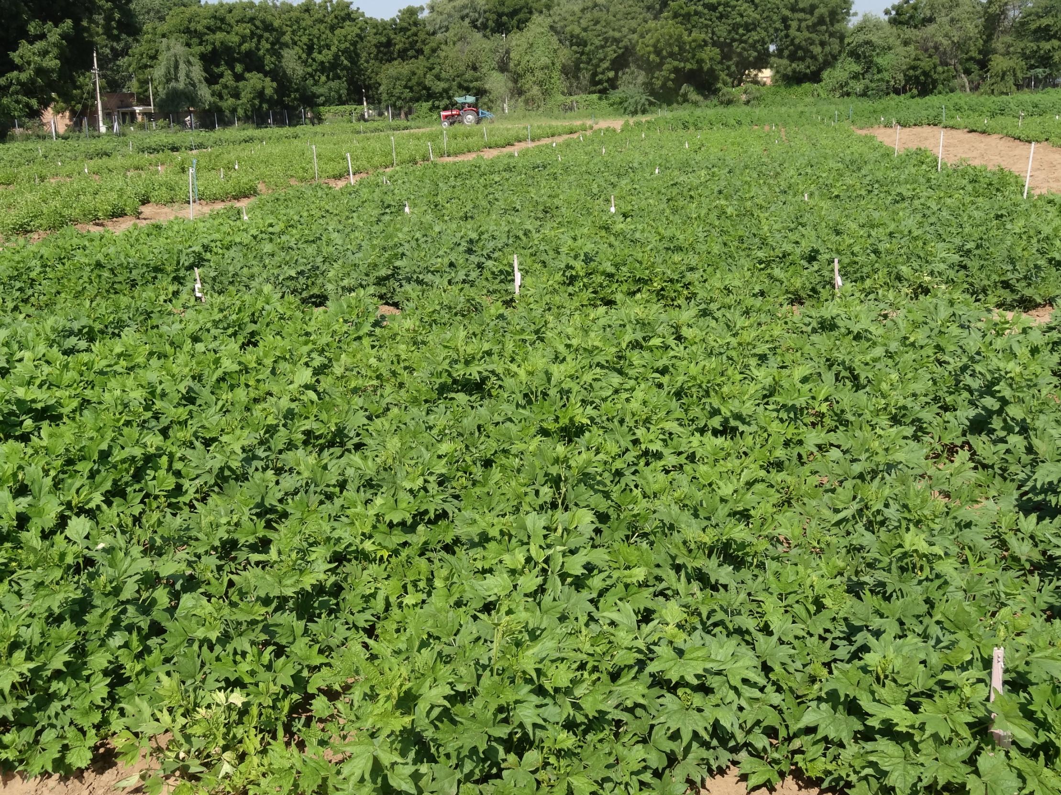
Moth Bean (Vigna aconitifolia) (18)
RMO-40 | Maru Moth
RMO-225 | GMO-1
RMO-257 | GMO-2
CAZRI Moth-1 | RMM-12
CAZRI Moth-2 | Jwala
CAZRI Moth-3 | Baleshwar
Jadia | IPCMO 880

Slide 28
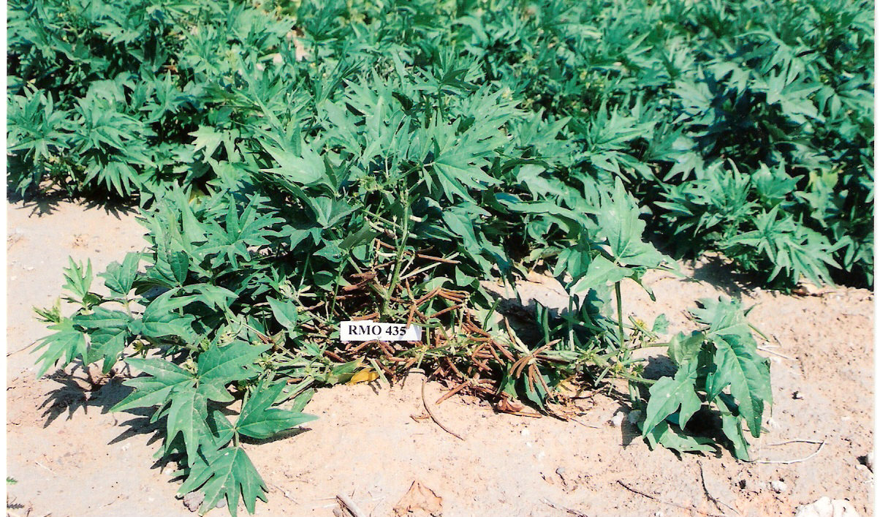
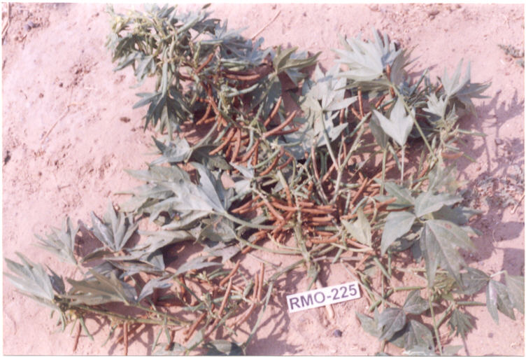
MOTHBEAN varieties
RMO 225
Early maturity (64-67 days), High seed yield (6.0-7.5q/ha) as well as fodder (18-19 q/ha) yield
Drought evasiveness
RMO 435
Early maturity
Drought evasiveness
High seed as well as fodder yield

Slide 29
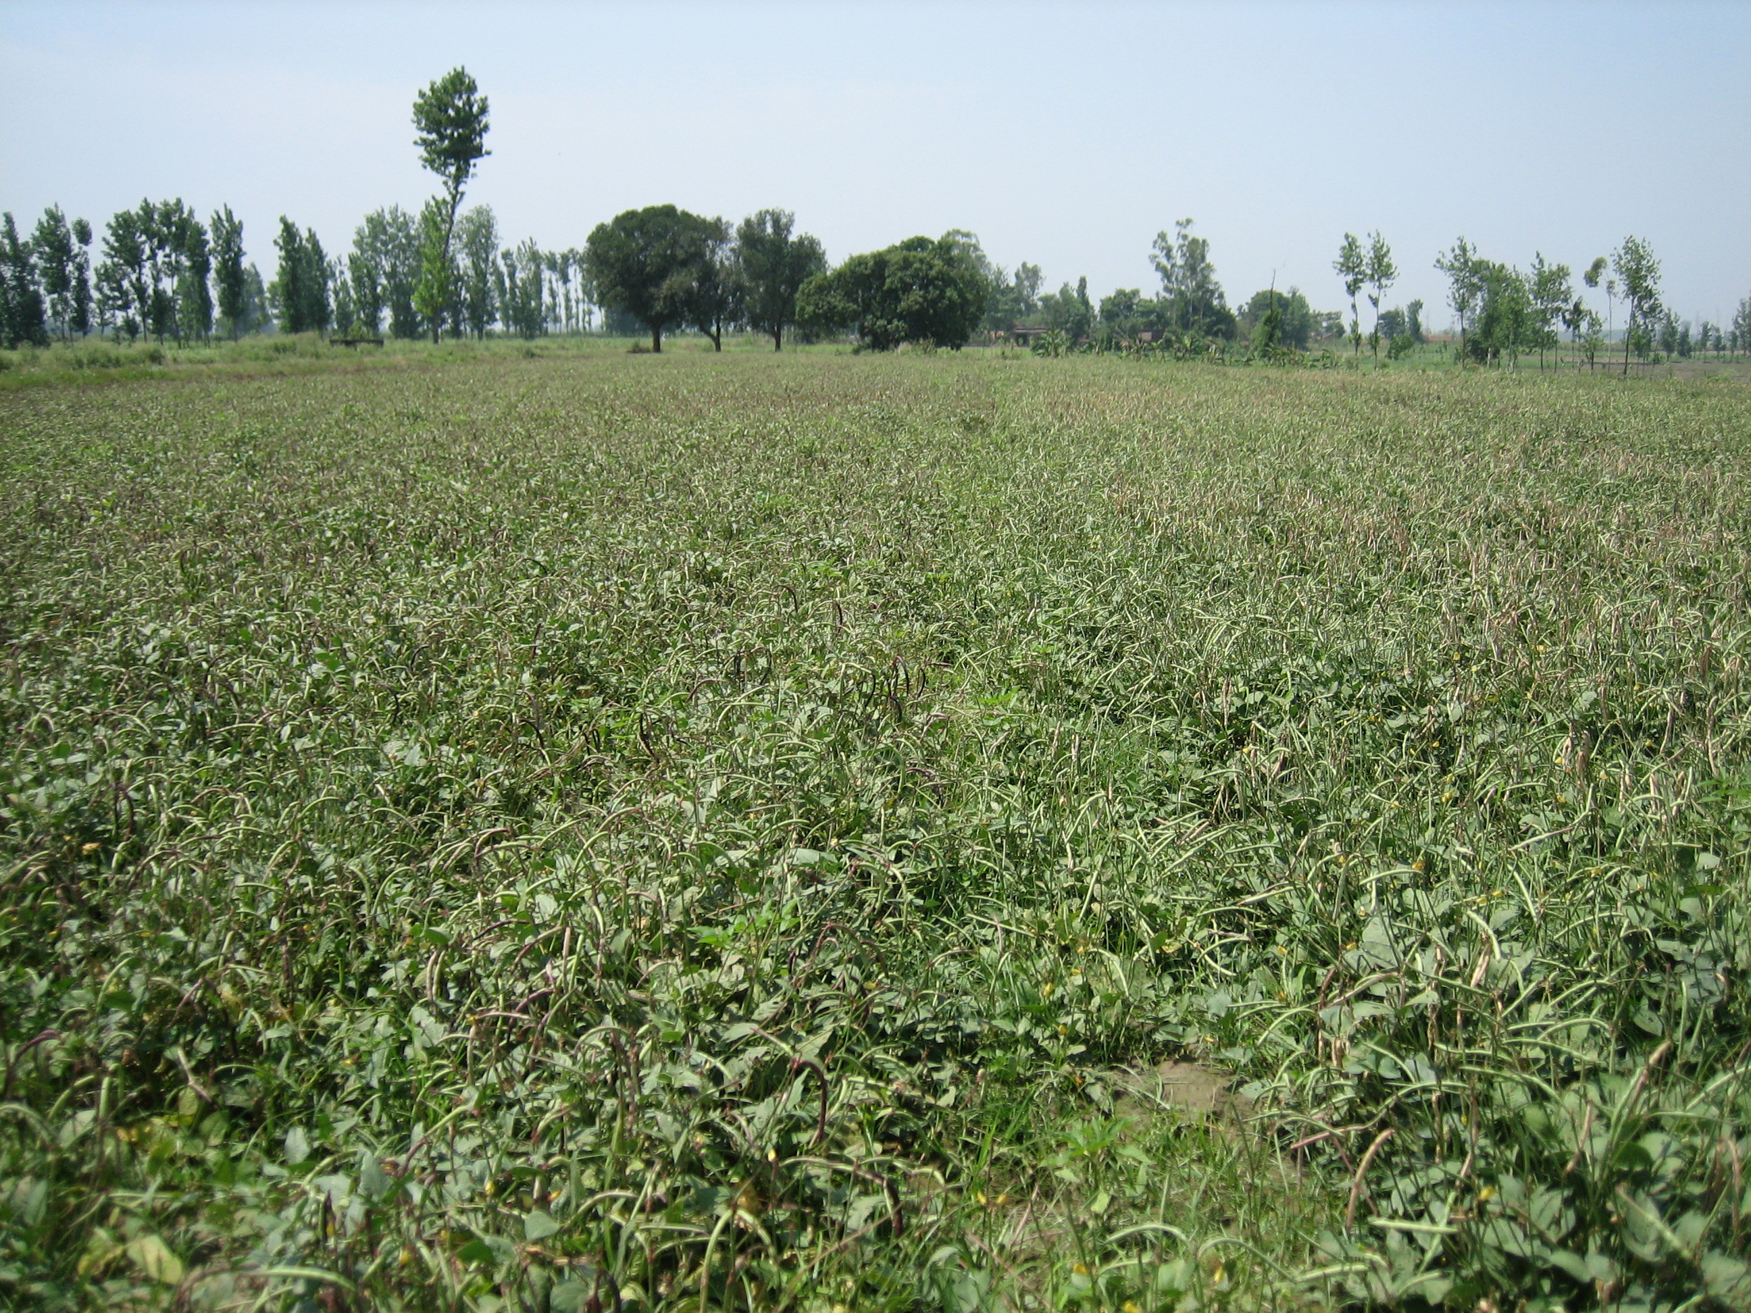
Cowpea (Vigna Unguiculata) > 100 varieties
Seed and vegetable types released all over India
A large number of varieties released at state level

Slide 31
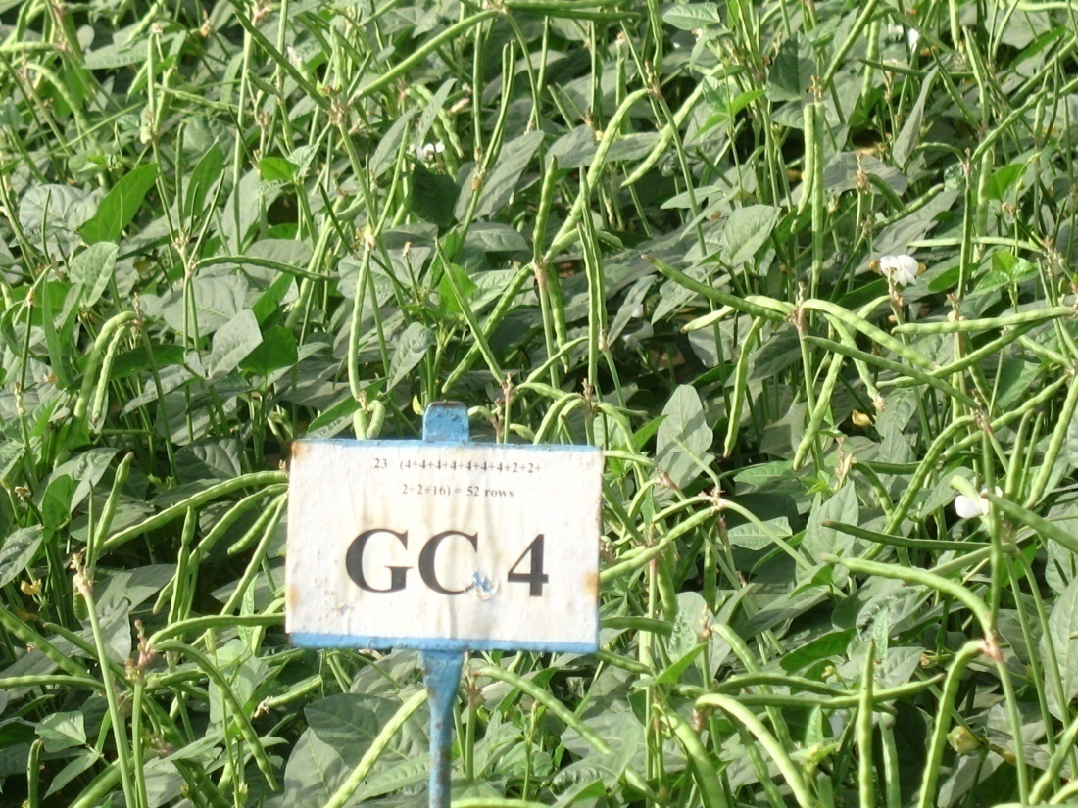

Slide 32
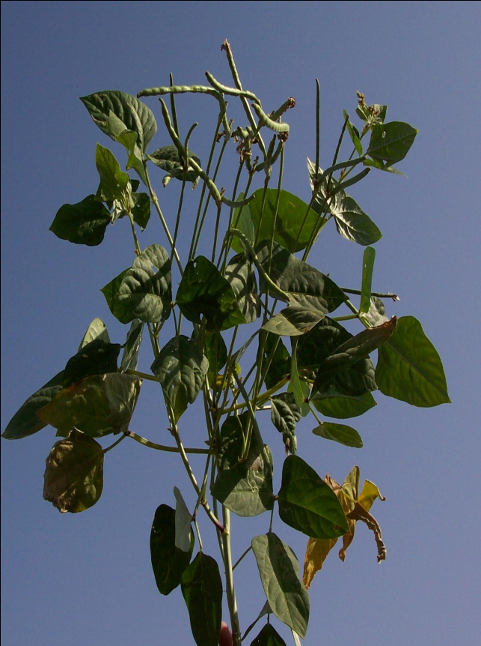
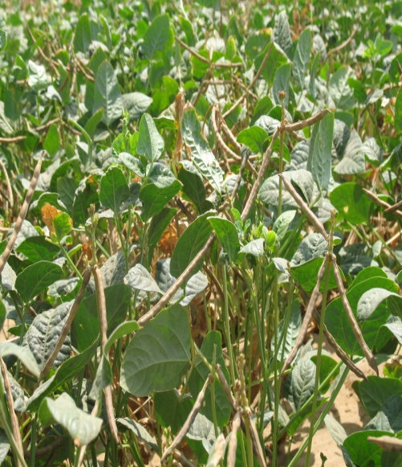
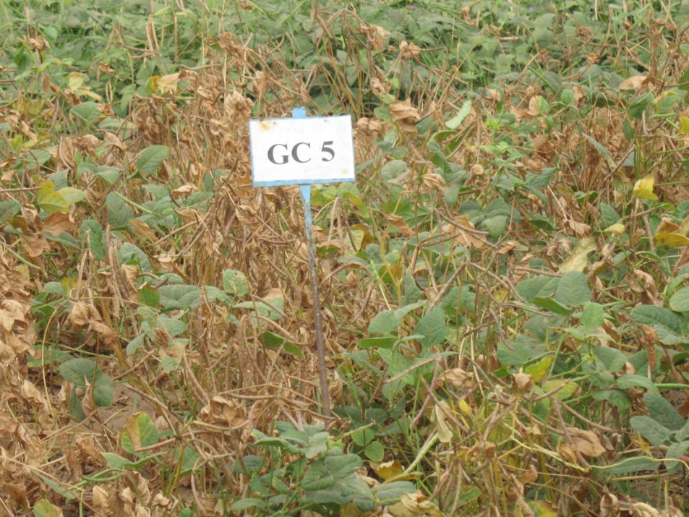

Slide 33
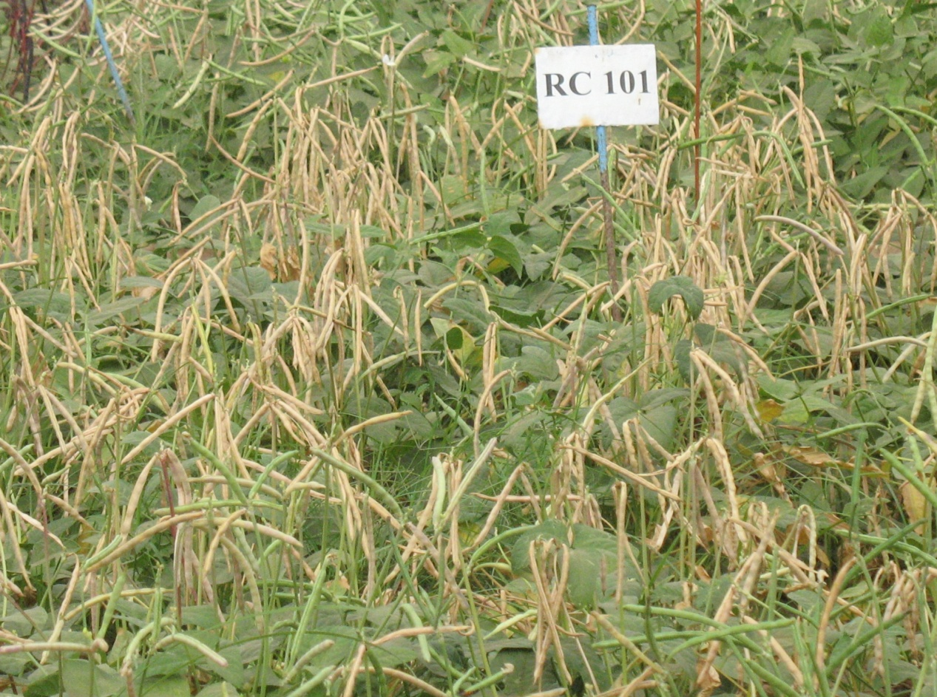
RC – 101:
This variety was developed also at Agricultural Research Station, Rajasthan Agricultural University, Durgapura by crossing a exotic strain IT 82D-652 x Fs – 68 and releases in 2001.
Early maturing only in 62-65 days synchronous maturity
Yield: 750 – 850 kg /ha.
Determinate in nature
Suitable for low rainfall zones.
The seed is white in color with black eye.

Slide 34
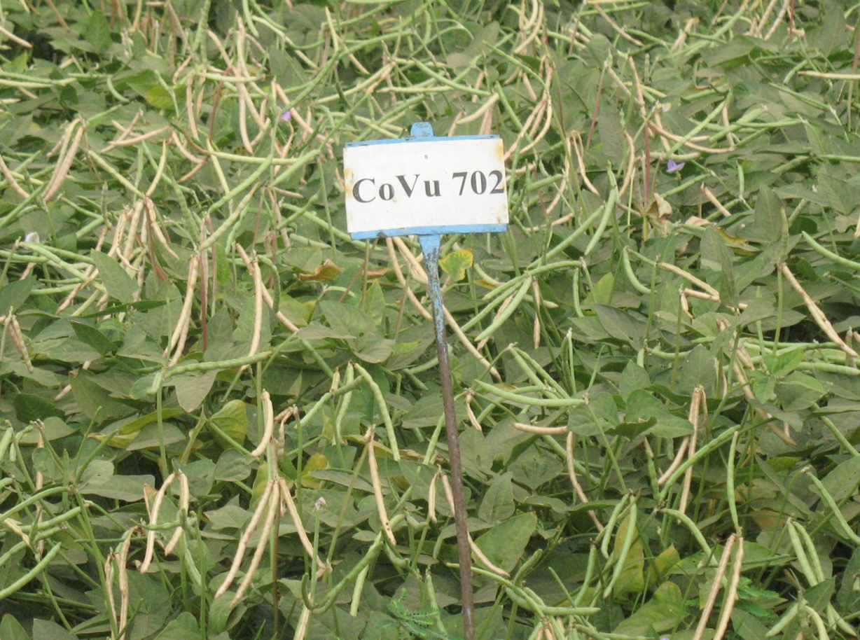
CoVu – 702:
This variety developed by Tamil Nadu Agricultural University, Coimbatore and was released for commercial cultivation in 2004
Matures synchronously in 67-73 d
Yield: 900 -1200 kg /ha
Seed: brownish white.
Moderately resistant to pod borer and tolerant to major diseases.
Rainfed as well as irrigated conditions of whole country but performs better under south Indian situations.

Slide 35
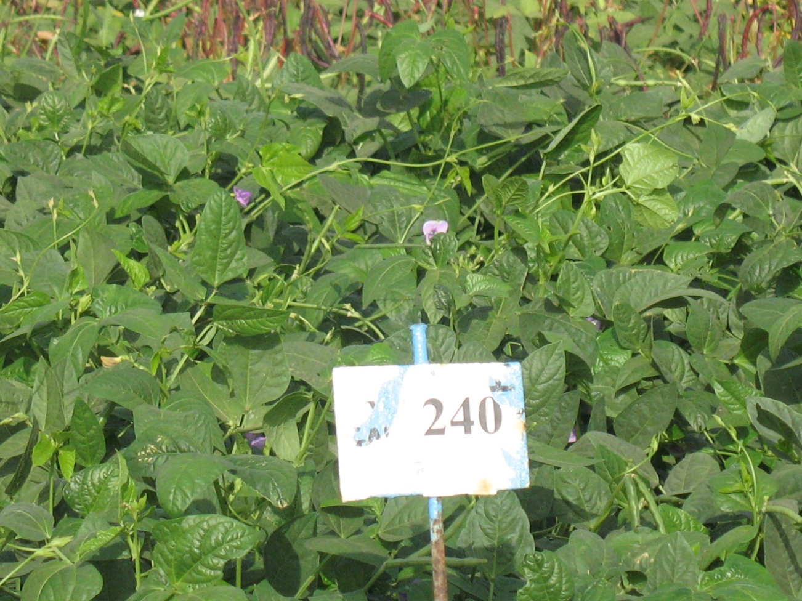
V – 240 (Rambha):
It was isolated from Pusa Falguni after chemical treatment with DMS at Indian Agricultural research Institute, Pusa, New Delhi and released in 1997.
Yield potential (1200 – 1500 kg/ha)
Matures in 90-95 days
It is known for its tall and trailing growth habit, dark green foliage and medium sized dark red seeds. It is highly adapted to arid and semi-arid regions with

Slide 36
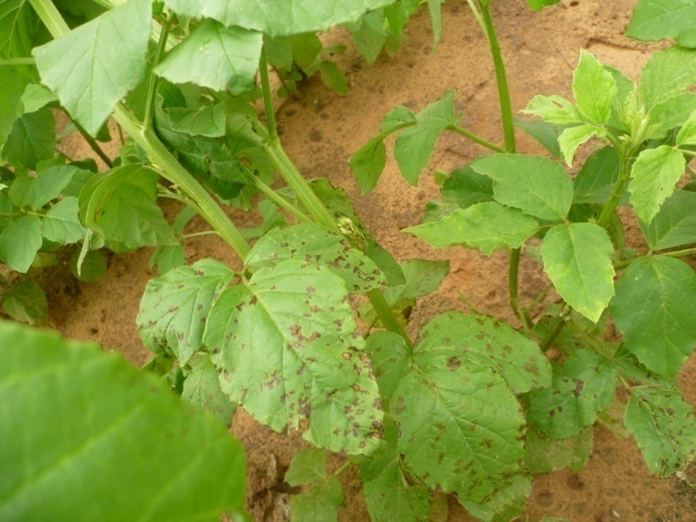
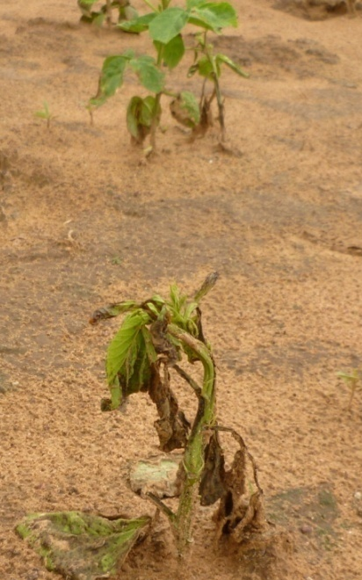
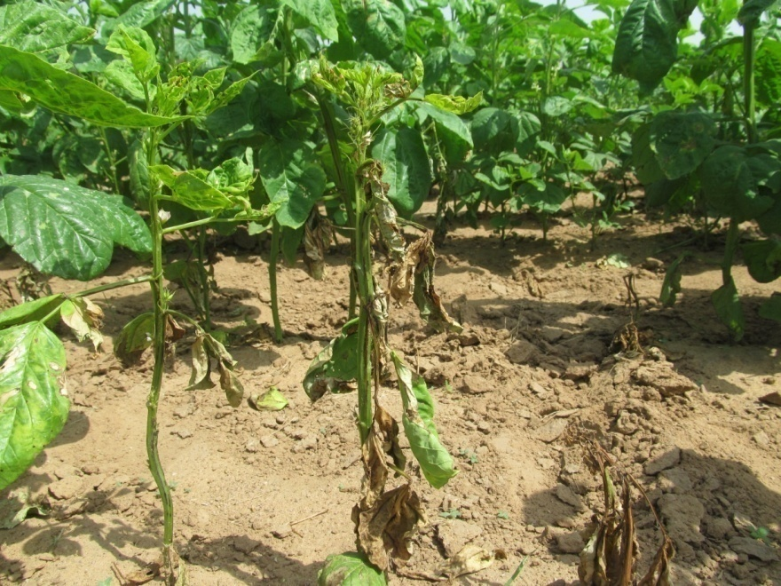
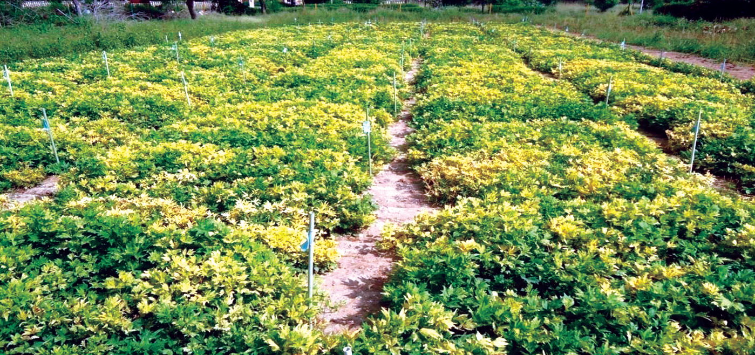
Disease resistance
A number of fungal and bacterial diseases are known to affect legumes:
Viral disease are more important:
Yellow mosaic virus
Leaf curl virus

Slide 37
Strategies to enhance production
Under the ambit of Indian Council of Agricultural Research,
Large number of high yielding varieties and
Matching integrated crop management technologies have been developed having capacity to
  Enhance pulses production to the tune of 25-30% within short span,
If appropriate policy support is provided to address various issues like infrastructure for
  life saving irrigation,
  Quality input supply,
  Storage,
  Buffers stock for seed and grains,
  Remunerative MSP (Minimum Support Price) and procurement,
  Market and issues dealing with import of some of the less preferred pulses etc.

Slide 38
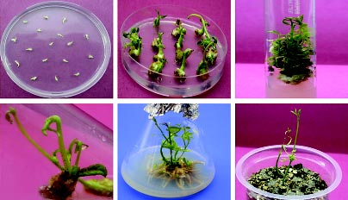
Opportunities for genetic enhancement

Slide 39
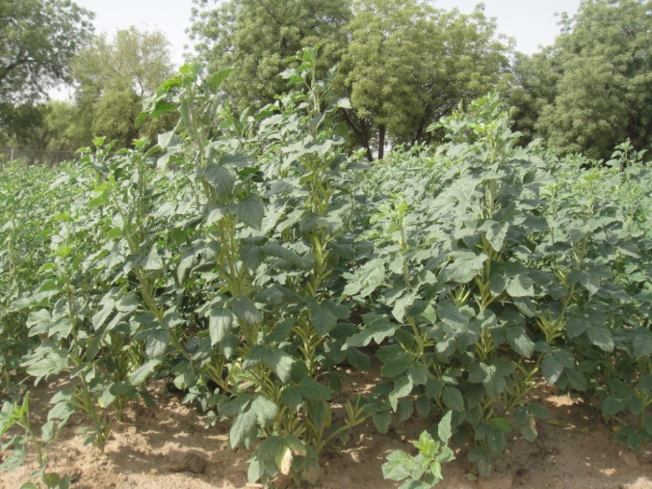
Crop/plant architecture:
Three-dimensional distribution of the vegetative and reproductive organs.
To improve
  Adaptation,
  Seed yield and
  stability
it impacts on
  Light Interception
  Pattern of radiation interception within the canopy,
  Dry matter accumulation and
  Assimilate partitioning to the vegetative compartment and the reproductive growth.

Slide 40
The main features of the grain legume architecture
Indeterminate growth habit, which may lead to
  Prolonged growth cycle
  Low or unstable harvest index and seed yields.
  Potentially long cycle and late ripening due to the prolonged vegetative phase
Vegetative phase gets prolonged with increased water and nutritional availability, the stress is almost exclusively required for timely flowering and proper partitioning
However, Early and dwarf genotypes are less affected by water regime

Slide 41
Ideotype Breeding
The definition of the optimum plant structure to
Maximize the yield
In this breeding approach the architectural characters are addressed considering
  physiology and
  Genetics of traits
Even when quantitatively inherited, they are usually more heritable than the seed yield and, in some cases, they are under a mono- or oligogenic control.

Slide 42
The different architectural components need to be analyzed and balanced towards higher and more stable seed yield
Three plant compartments may be considered:
  Root,
  Vegetative (stems and leaves) and
  Reproductive compartments (seeds and the pod wall)

Slide 43
Flowering date:
Not an architectural character per se, but its implications on plant architecture are enormous
The pattern of assimilate partitioning between the vegetative and the reproductive compartments are modified by different architectural traits.
The dwarfism may also influence the reproductive/ vegetative ratio through a modification of the pattern of resource allocation
Early flowering (photo-thermo insensitive) genotypes yield high

Slide 44
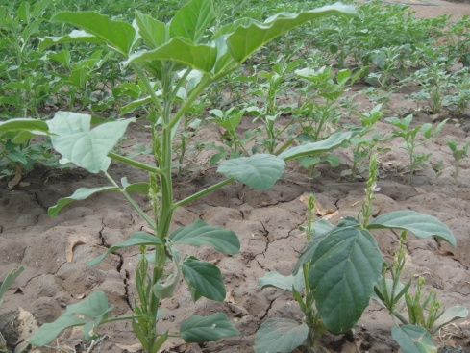
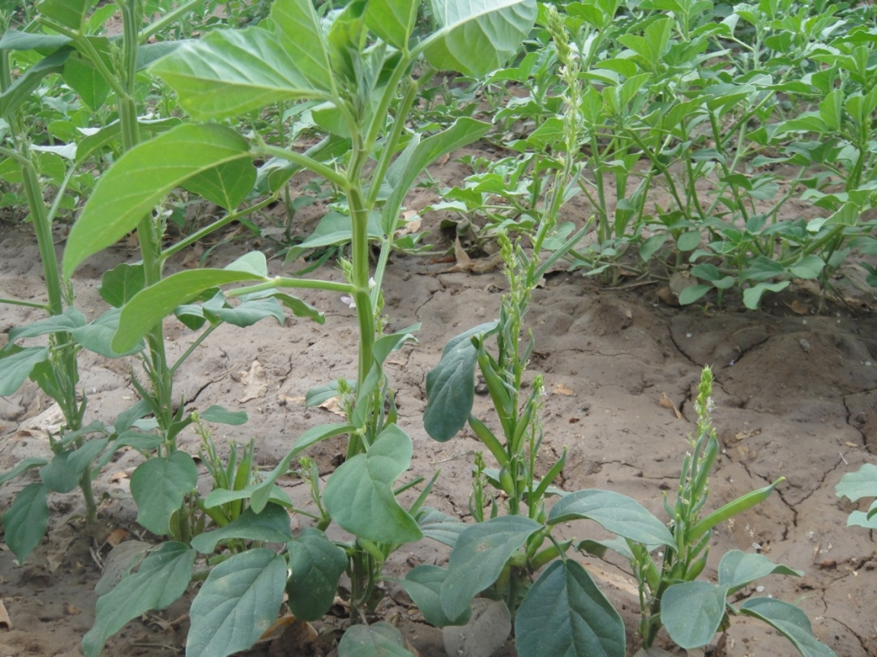
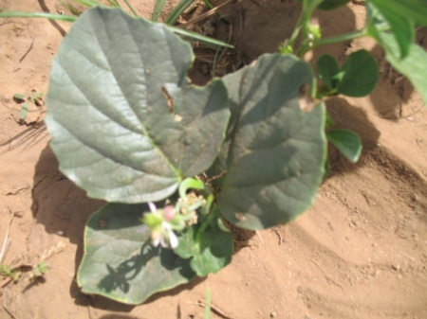
DWARFISM
Dwarfing genes were often reported to have a pleiotropic effect on other characters than the internode length.
They may influence the branching pattern because of modifications in the assimilate partitioning
Increase Harvest index
Days to Flowering
A considerable variability for plant height is available in legumes (dwarf upright to trailing types)
Dwarf types may or may not offer advantage of early flowering and maturity

Slide 45
The indeterminate
In the cultivated populations, it offers the ability to
Compensate for large variations of the stand density or to
Produce additional vegetative and reproductive organs after stress
Determinate :
The determinate growth habit, at a given time of the growth cycle, induces allocation of all the assimilates to the reproductive growth.
The structure of the reproductive compartment has little been considered in the breeding of grain legumes. However, there is a need to examine the possible existence of a genetic variability
  To optimize the physiological role (photosynthesis and reallocation)
  proportion of biomass which is stored in it at harvest,

Slide 46
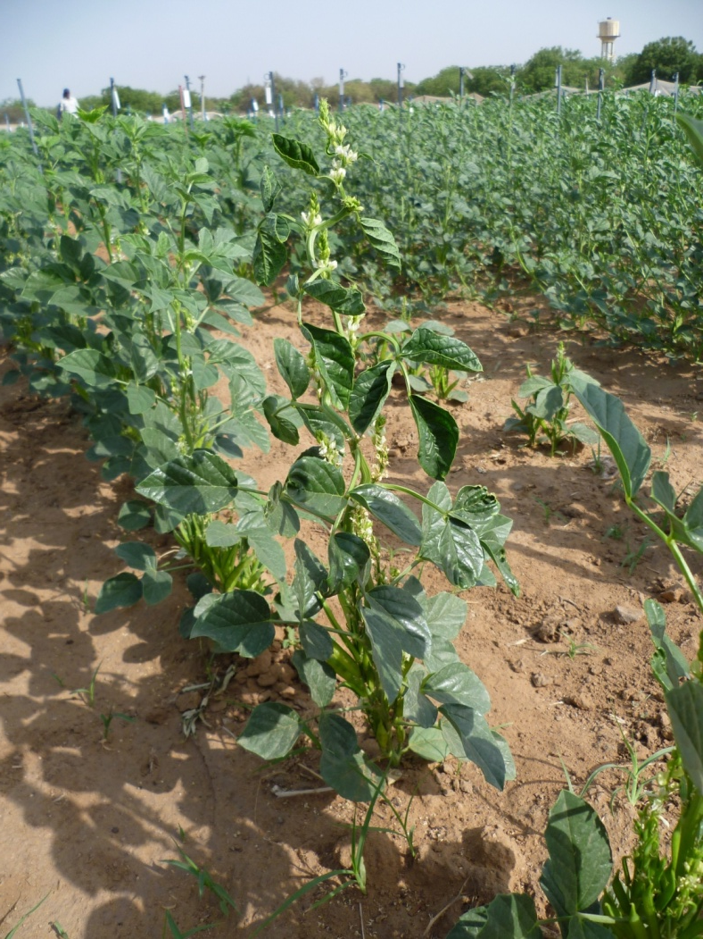
Yield potential of determinate types
There is no general trend to conclude an advantage of one type over the other
The genetic background as well as the other architectural features must be adapted to get the optimum expression of the determinacy.
Yield stability of determinate types:
Contrasting effects have been reported for stability of yield
Stability seems to be genotype-dependent more than architecture type-dependent.

Slide 47
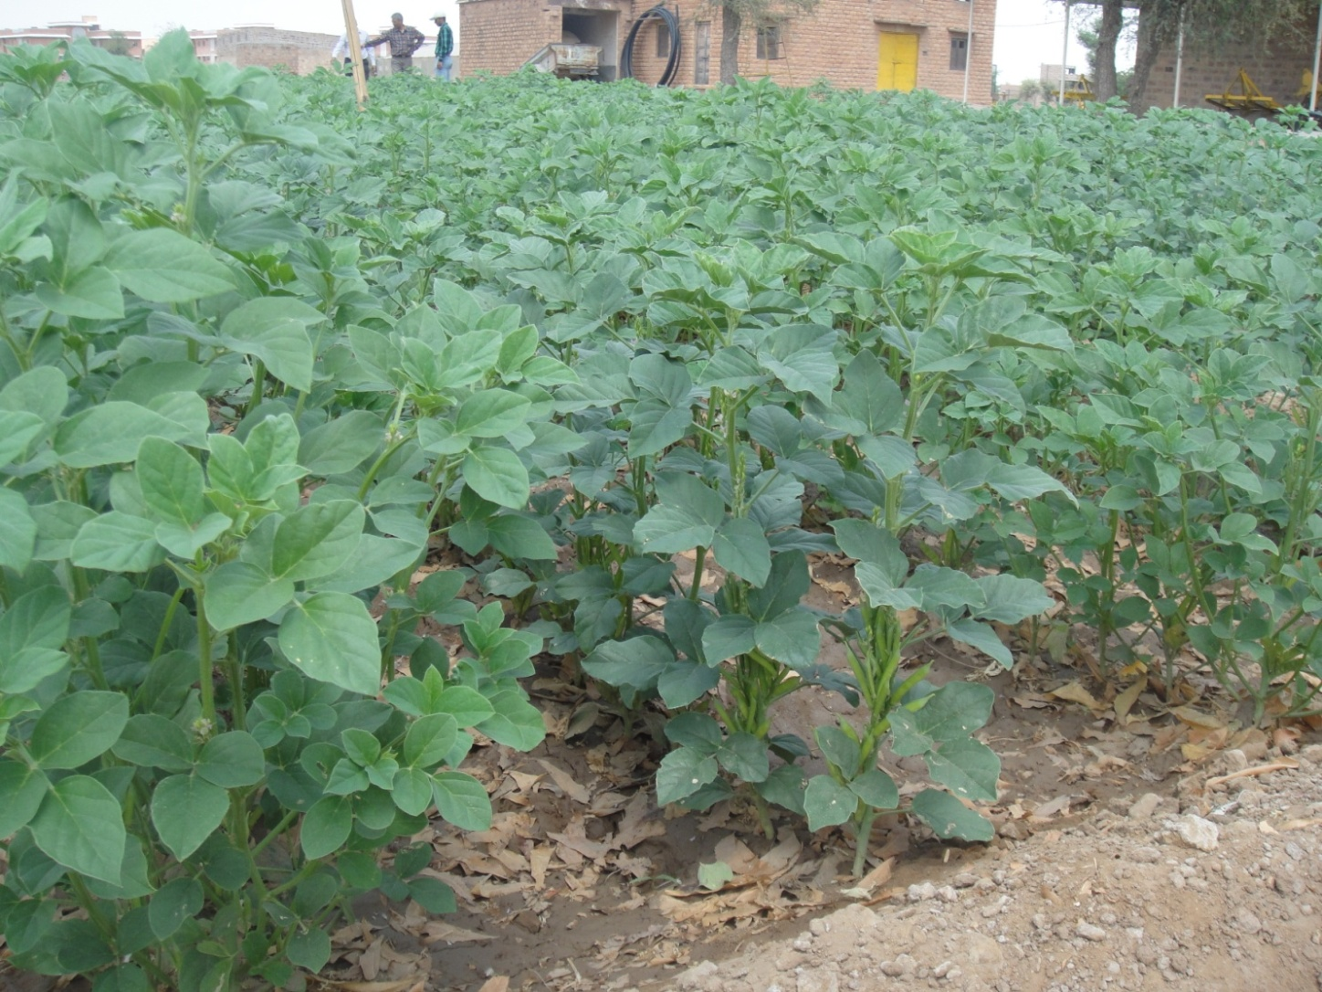
Early flowering than early maturing or determinate type is more advantageous for stability
Water stress induced senescence in such types diverts food material of leaves in pods to stabilize the yield

Slide 48
MODIFICATION OF THE STRUCTURE OF THE PODS
Very fleshy especially in vegetable types
photosynthesize when fully exposed to light.
Most of the assimilated carbon was rapidly exported to the seeds on maturity
The thick pod walls may contribute to the C and N metabolisms of the pod and the grains through relocation during the seed filling.
However, the harvest index of the crop may be low because of the low harvest index of the reproductive compartment itself.
Despite its metabolic importance and possible impact on the harvest index, little attention has been paid to the structure of the pod walls and pod wall proportion in grain legumes
Breeding for smaller leaves might improve water efficiency and stress tolerance without yield loss.

Slide 49
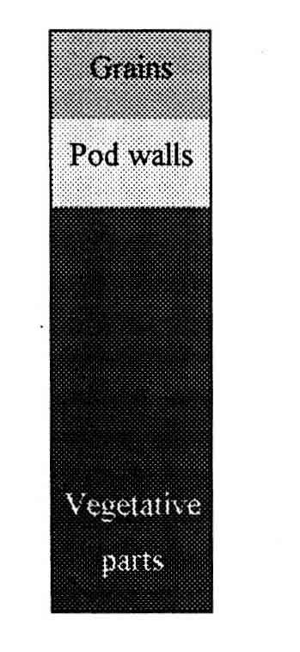
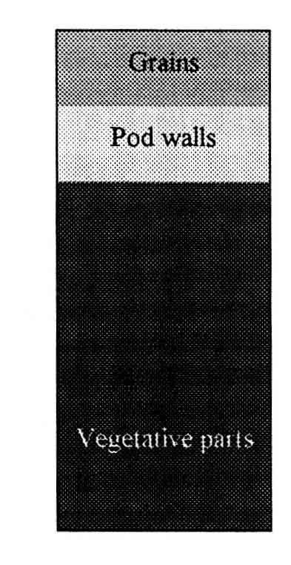
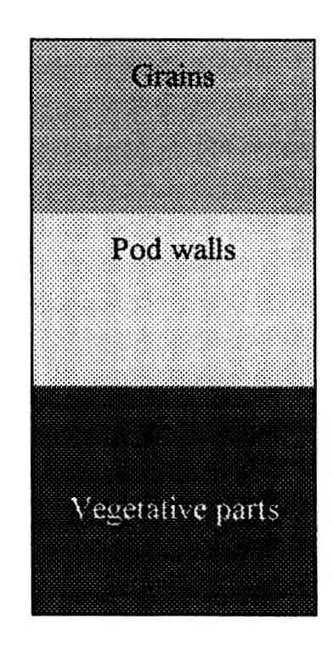
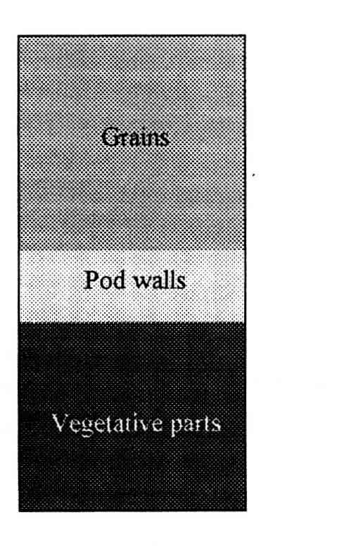
1 Increasing the biomass
2 Increasing the allocation to reproductive organs
3 reducing the proportion of pod walls
Different strategies to increase seed yield through modifications of architecture (Huyghe and Ney)

Slide 50
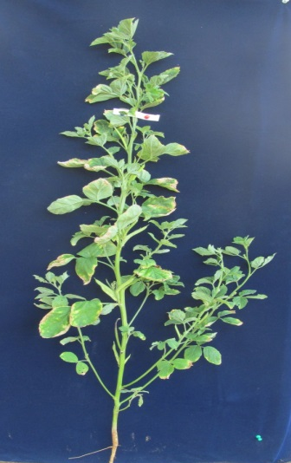
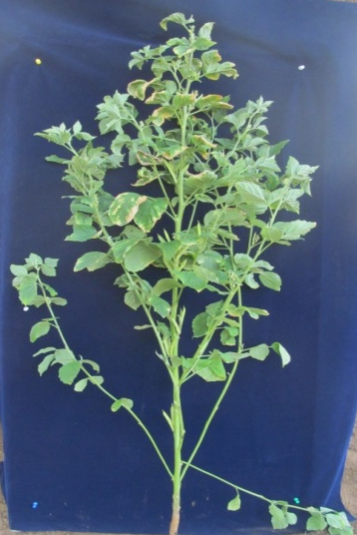
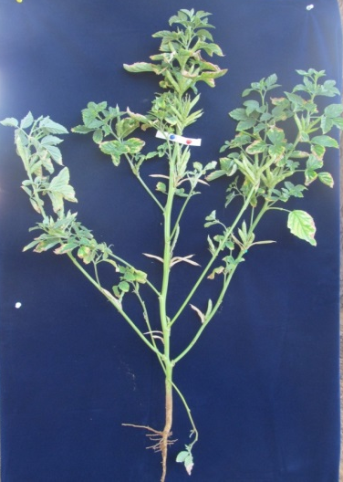
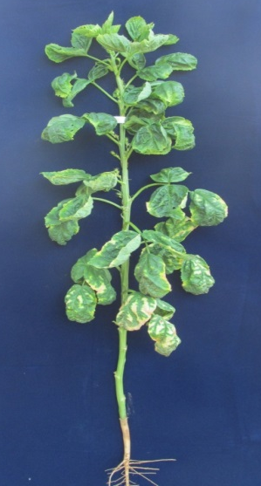
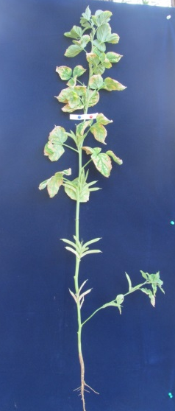
BRANCHING PATTERN
The production of branches have been studied in most grain legumes. This trait is affected both by the genetics and by the environmental conditions during growth. It is very sensitive to the plant density.
Genes that directly modify the pattern of branching have been identified in grain legumes.
Affect yield with changing crop density.
Influence bearing on main stem
RGC 936
RGC 1066
GG2
BG2
FS 277

Slide 51
Prospects :
Architectural characters may be combined to improve yield and stability.
Dwarf determinate and flowering genes in combinations have been successful in legumes.
The breeding programmes must be designed to increase the genetic variability within the optimized architecture and then to carry out a selection for the targeted agronomic objectives in this material.
The architectural modifications may, in most cases, contribute to reduce the vegetative development of the crops and increase the assimilate partitioning towards the reproductive growth and the grains.
Some of the architectural modifications have been tagged with molecular markers for more precise breeding

Slide 52
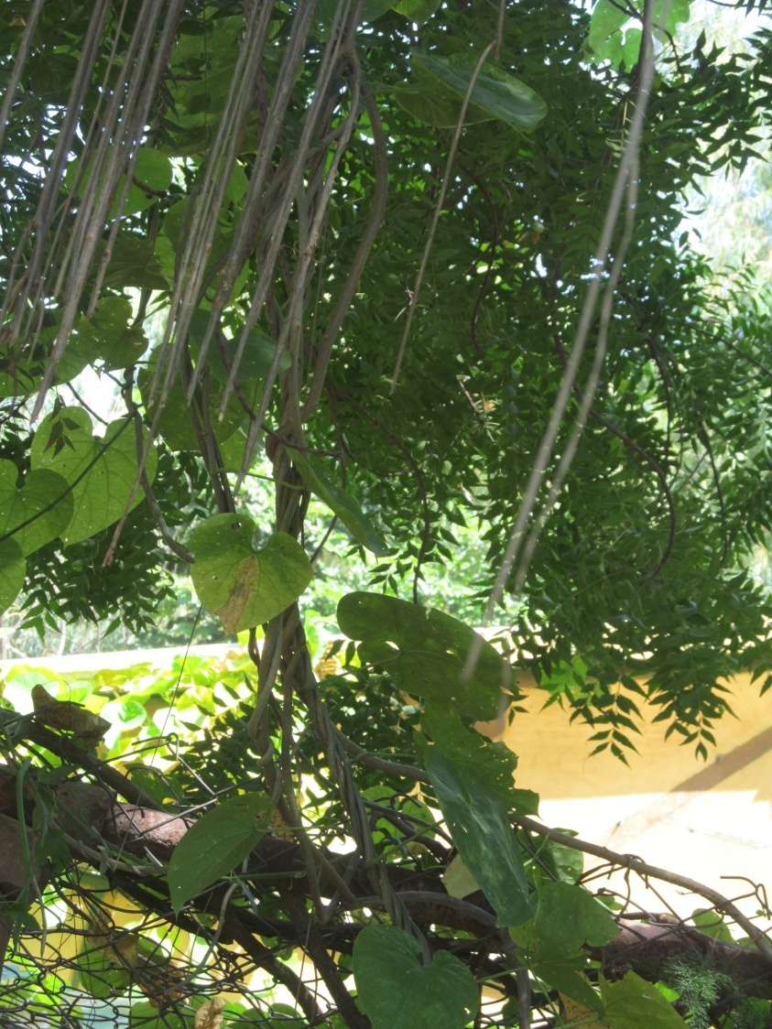
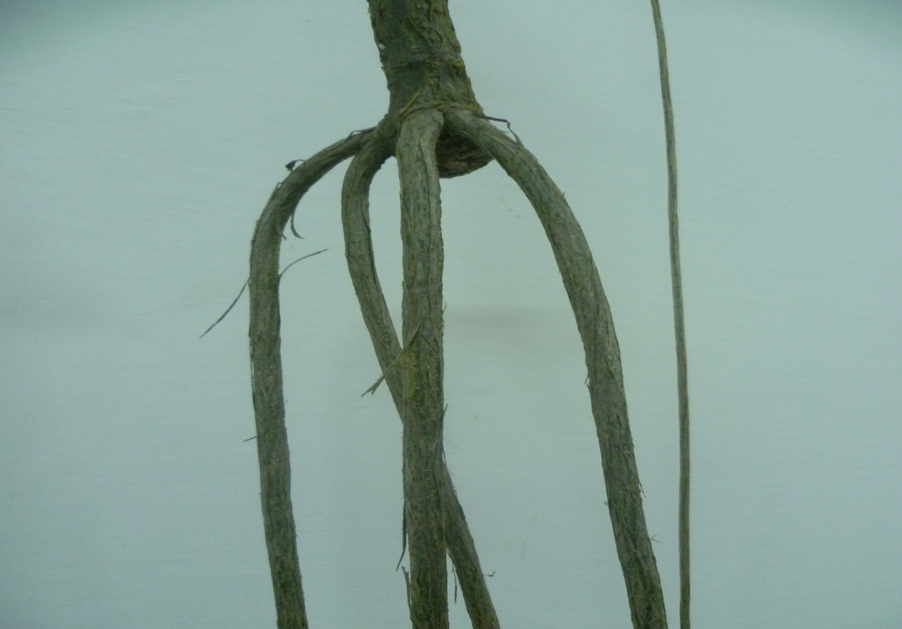
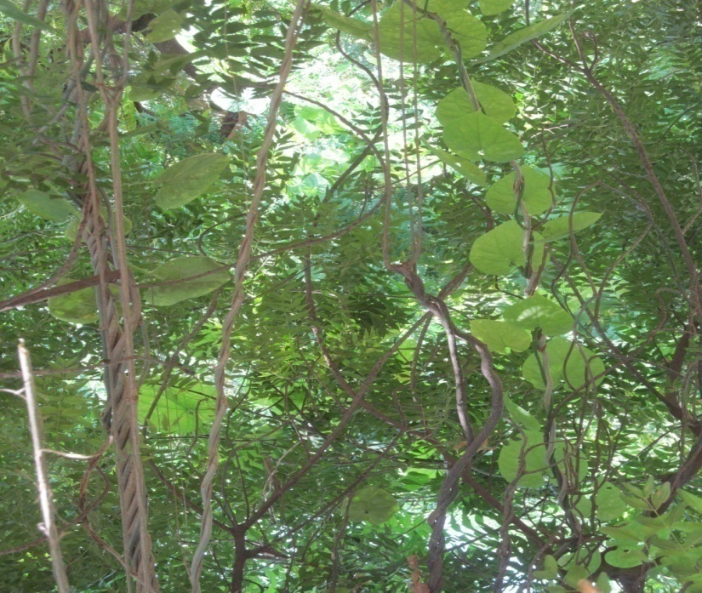
Thanks
Giloy
Tinospora cordifolia

